Slide 1



Medication Supply Resilience Program MetroCare Health System
Geoffrey Threats, MBA – ERP, MS - MIS
ADTA 5830 – Risk & Value
SPRING I - 2026
Notes:
Good afternoon. My name is Geoffrey Threats, and today I’ll be presenting the Medication Supply Resilience Program for MetroCare Health System.
This presentation focuses on one of the most urgent operational risks facing healthcare systems today, medication supply disruption.
Using a structured risk prioritization approach, operational analysis, and practical analytics integration, I will walk through these key points:
• Why this risk ranks highest • What is driving instability • A two-phase mitigation strategy • Key performance indicators • And most importantly, the executive value this program creates
This proposal is designed to be realistic, measurable, and scalable across the enterprise
This is not a long-term transformation proposal. It is a disciplined, cost-conscious resilience strategy designed to reduce stockouts by up to 30% within nine months.

Slide 2
Risk & Urgency
8–12% of critical medications impacted monthly
Frequent backorders & manual tracking
Emergency procurement cost volatility
Direct patient safety exposure
Weighted Risk Score: 4.9 / 5 (Highest of 4 domains)
Notes:
Medication supply disruption currently impacts approximately 8 to 12% of critical medications each month.
That translates into frequent backorders, manual workarounds, emergency procurement, and direct patient safety exposure.
Using a weighted risk scoring framework across four enterprise domains, operational, financial, compliance, and reputational, Medication supply disruption scored a 4.9 out of 5, the highest of all identified risk categories.
Operationally, we see: • Procedure delays • Clinical substitutions • Increased staff workload • Workflow instability
Financially: • Premium freight costs • Budget variance • Margin instability
From a leadership standpoint, Medication supply disruption is not just a pharmacy issue, it is a system-wide operational risk with downstream financial and safety implications.
That is why this risk was prioritized above all others.

Slide 3
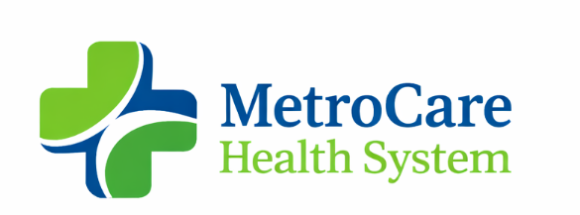
Risk Prioritization Framework
Criteria | Weight | Medication Supply | Cyber Risk | Workforce Shortage
Patient Safety Impact | 30% | 5 | 4 | 4
Financial Impact | 25% | 5 | 4 | 4
Likelihood (Current State) | 20% | 5 | 3 | 4
Operational Dependency | 15% | 5 | 4 | 4
Regulatory Exposure | 10% | 4 | 5 | 3
Weighted Score | 100% | 4.9 | 4.0 | 4.1
Notes:
To ensure this was not a subjective choice, a weighted risk scoring model was applied across four enterprise risks. Each risk was evaluated across patient safety impact, financial impact, likelihood, operational dependency, and regulatory exposure.
Medication supply disruption received the highest weighted score at 4.9 out of 5, primarily due to its daily occurrence and system-wide operational dependency. While cyber risk carries severe potential consequences, its likelihood is episodic.
Medication instability is a persistent and already compounding operational strain.

Slide 4
Enterprise Impact
Operational
Financial & Risk
Procedure delays
Clinical substitutions
Increased staff workload
Workflow disruption
Premium freight costs
Budget variance
Margin instability
Reputational exposure
Notes:
Medication supply disruption is not simply a pharmacy issue. It affects surgery scheduling, clinical workflows, revenue predictability, and executive visibility. The instability creates cascading operational strain across the enterprise.

Slide 5

Root Causes (Controllable)
What’s Driving the Instability?
Limited inventory visibility across sites
Weak demand forecasting discipline
Vendor concentration risk
Inconsistent data definitions
Notes:
When we examine the drivers of instability, the issue is not randomness, it is controllable structural gaps.
Four primary root causes were identified:
First, limited inventory visibility across sites.
Second, weak demand forecasting discipline.
Third, vendor concentration risk.
Fourth, inconsistent data definitions across systems.
From my supply chain background, these issues are common when organizations grow faster than their analytics governance structure.
When inventory data lacks standardization and forecasting lacks oversight, variability increases.
This program addresses those structural weaknesses directly, not just the symptoms.

Slide 6

Strategy Overview
Two-Phase Medication Supply Resilience Program
Phase 1 (0–90 Days)Inventory Visibility & Standardization
Phase 2 (3–12 Months)Forecasting & Shortage Alert Framework
Notes:
The strategy is intentionally sequenced.
First, we stabilize visibility and governance.
Then, we optimize forecasting and vendor discipline.
No major ERP replacement. No large capital investment. The mitigation plan is structured into two deliberate phases.
Phase 1 focuses on stabilization and visibility within the first 90 days.
Phase 2 focuses on forecasting maturity and proactive shortage prevention across 3 to 12 months.
This sequencing is intentional.
Before we optimize forecasting, we must first stabilize data definitions, reporting structure, and threshold controls.
This approach ensures quick wins while building sustainable analytics capability.

Slide 7
Data Governance & Ownership
Metric Category | Primary Owner | Supporting Function | Review Cadence
Inventory Levels & Stockouts | Pharmacy Leadership | Supply Chain Ops | Weekly
Forecast Variance | Supply Chain Analytics | Pharmacy Ops | Monthly
Emergency Procurement Cost | Finance | Supply Chain | Monthly
Vendor Fill Rate | Procurement | Finance | Quarterly
Substitution Rate | Pharmacy Clinical Lead | CMO Office | Monthly
Notes:
A key component of this program is clear accountability.
Each KPI has a designated primary owner and defined review cadence.
Inventory metrics are reviewed weekly by pharmacy leadership.
Forecast variance is reviewed monthly by supply chain analytics.
Emergency procurement costs are reviewed jointly with finance.
Vendor performance is reviewed quarterly.
This governance structure ensures metrics drive action rather than passive reporting.

Slide 8

Phase 1: Stabilize (0–90 Days)
Immediate Actions
Tier 1 medication classification
Weekly consolidated inventory dashboard
Centralized shortage log
Reorder threshold definitions
Executive visibility reporting
Notes:
Within 90 days, MetroCare will have standardized medication classifications, weekly consolidated reporting, threshold-based monitoring, and executive-level visibility into shortage trends and emergency procurement costs.
Phase 1 includes five immediate actions:
• Tier 1 medication classification • Weekly consolidated inventory dashboard • Centralized shortage log • Defined reorder thresholds • Executive visibility reporting
This phase focuses on operational discipline and transparency.
It is low complexity, high impact. The goal in the first 90 days is clarity and control.
By classifying critical medications and standardizing reporting across facilities, leadership gains immediate insight into risk exposure.
The weekly dashboard provides early warning signals.
Defined reorder thresholds reduce reactive procurement.

Slide 9

Phase 2: Forecast & Prevent (3–12 Months)
Structural Improvement
12–18 month usage trend analysis
Reorder point calibration
Automated shortage alerts
Monthly forecast governance
Vendor performance review cycle
Notes:
Once stability is achieved, Phase 2 introduces predictive governance.
The objective here is prevention rather than reaction.
By tightening forecast variance and monitoring vendor fill rates, the system moves from reactive firefighting to controlled planning.
Key components include:
• 12–18 month usage trend analysis • Reorder point recalibration • Automated shortage alerts • Monthly forecast governance reviews • Vendor performance monitoring
This phase builds long-term resilience.
It also advances MetroCare’s analytics maturity.

Slide 10
KPIs & Measured Success
Financial
KPI | Target | Expected Impact | Status
Emergency Procurement Cost | ↓ 15–25% | Margin stabilization | 🟢
Stockout Rate | ↓ 20–30% | Operational reliability | 🟢
Forecast Variance | < 10% | Planning accuracy | 🟢
Vendor Fill Rate | ≥ 95% | Supply reliability | 🟢
Substitution Rate | ↓ 15% | Patient safety risk reduction | 🟢
15–25% reduction in emergency procurement cost
Reduced drug acquisition cost variance
Operational
20–30% reduction in stockout rate
<10% forecast variance
Risk & Reliability
≥95% vendor fill rate
15% reduction in substitution rate
Notes:
Success is measured in measurable, executive-relevant outcomes. This program defines KPIs across three categories:
Financial: • 15 to 25 percent reduction in emergency procurement cost • Reduced drug acquisition cost variance
Operational: • 20 to 30 percent reduction in stockout rate • Forecast variance under 10 percent
Risk & Reliability: • Vendor fill rate of at least 95 percent • 15 percent reduction in clinical substitution rate
These metrics connect directly to margin protection, operational continuity, and patient safety.
They also allow executive tracking at the board level.

Slide 11
Implementation Roadmap
0–90 Days
3–12 Months
Dashboard live
Threshold alerts active
First executive performance report
Forecast variance reduced
Vendor performance stabilized
Stockout trend declining
Notes:
Execution is structured, not theoretical. Deliverables are visible within 90 days, with measurable optimization within 12 months. Governance meetings ensure accountability without additional headcount.
The roadmap clearly separates short-term stabilization from longer-term optimization.
Within 90 days: • Dashboard goes live • Threshold alerts become active • First executive performance report delivered
By 12 months: • Forecast variance reduced • Vendor performance stabilized • Stockout trends declining
This phased implementation minimizes disruption while building measurable progress.

Slide 12
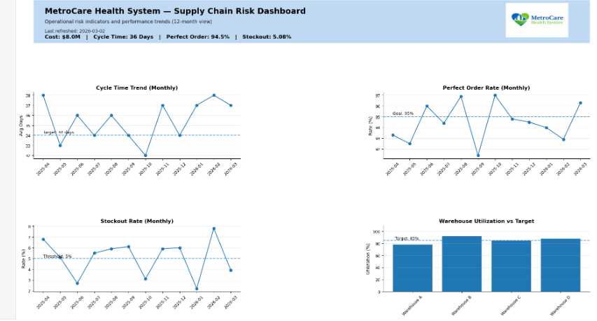
Executive Value
What Leadership Gains
Enterprise-wide supply visibility
Margin predictability
Reduced patient safety exposure
Lower workflow disruption
Scalable analytics maturity
Example Dashboard Created by Geoffrey Threats
Notes:
From a leadership perspective, the value created is substantial.
First, enterprise-wide supply visibility enhances strategic decision-making.
Second, patient safety exposure decreases due to reduced stockouts and substitutions.
Third, workflow disruption declines as manual workarounds decrease.
Fourth, margin predictability improves through cost stabilization.
And finally, scalable analytics maturity positions MetroCare for future operational improvements beyond pharmacy.
This program transforms medication supply from a reactive vulnerability into a managed strategic asset. The example dashboard demonstrates how leadership would monitor performance in real time.
It includes:
• Cycle time trends • Perfect order rate • Stockout rate • Warehouse utilization against target
This provides a consolidated operational view.
Rather than reacting to isolated complaints, executives can monitor performance trends monthly and intervene proactively.
This level of visibility reduces uncertainty and supports data-driven leadership decisions.
In conclusion, medication supply disruption represents MetroCare’s highest operational risk.
However, with structured prioritization, disciplined execution, and practical analytics integration, this risk can be mitigated effectively.
This Medication Supply Resilience Program provides a clear, phased, and measurable path forward.
Thank you for your time. I look forward to any questions.

